Slide 1
Chapter 10
World Tensions

Slide 2
A. Indian Independence
World War II left Britain with enormous war debts which led to them granting India independence.
The only problem Britain had was deciding who deserved to receive power, the Hindus or the Muslims
The two sides each had their own representation. The Congress Party was India’s national political party who was predominately controlled by the Hindus.
The Muslim League was an organization who was founded in order to compete against the Congress Party and protect Muslim Interest

Slide 3
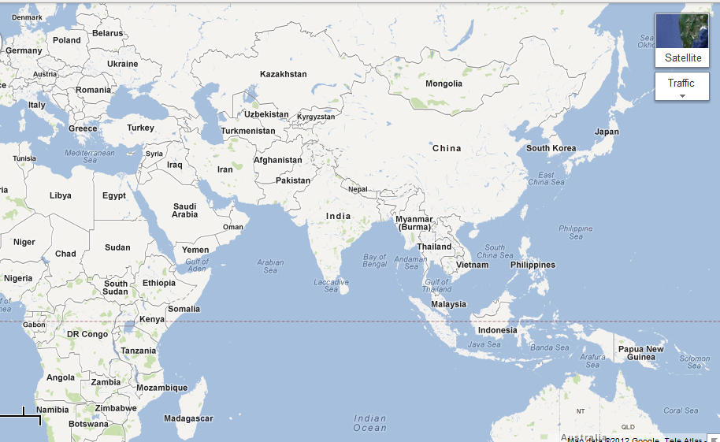

Slide 4
A. Indian Independence pg.2
Rioting began to break out between the two and resulted in Britain officials determining that partition was the best way to ensure a safe and secure region.
The northwest region and eastern regions of India, where most Muslims lived would become Pakistan.
On July 16, 1947 the British House of Commons passed an act that granted the two nations, India and Pakistan, independence.
In a short period of time, some 10 million people had to decide which nation to join
During the summer while different religious groups were relocating, violence broke out and up to 1 million people were killed.

Slide 5
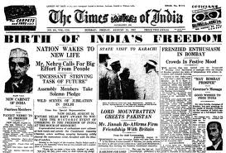
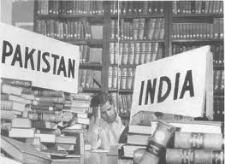

Slide 6
A. Indian Independence pg.3
With the granting of their independence, India became the worlds largest democracy.
Jawaharlal Nehru became India’s first prime minister and led the nation for 17 years until he died in 1964.
Nehru’s daughter, Indira Gandhi, took control of India following her fathers death and ruled until she was assassinated in 1984.

Slide 7
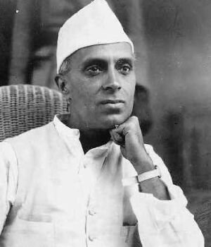
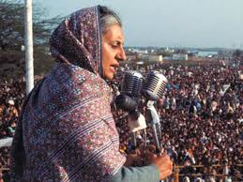
Jawaharla Nehru
Indira Gandhi

Slide 8
B. African Independence
The African push for independence began before World War II. French speaking Africans and West Indians formed a movement to celebrate African culture, heritage, and values.
When World War II broke out, the African soldiers fought along side the French to “defend freedom.” When they returned home they were unwilling to accept colonial domination.

Slide 9
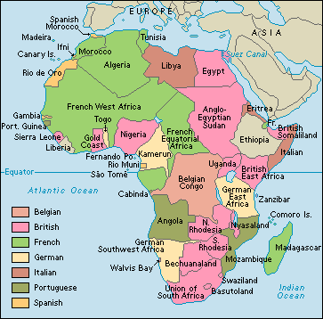

Slide 10
B. African Independence pg.2
The Gold Coast was the first colony to achieve independence. Through boycotts and strikes the people of the Gold Coast were able to receive independence in 1957, naming it Ghana in honor of the famous kingdom of the past.
Unlike Ghana, Kenya had to fight for its freedom. After years of guerrilla war tactics and attempts to push British settlers out, they were granted their independence in 1963.

Slide 11
B. African Independence pg.3
Perhaps no African nation has seen more bloodshed than Rwanda.
After gaining it’s independence in 1962 they experienced ethnic tension between the Hutu and Tutsi people.
Following the Rwandan presidents suspicious death in a plane accident, Hutus slaughtered about 1 million Tutsis before Tutsis rebels put an end to the killings.
The U.N set up a tribunal to punish those responsible.

Slide 12
C. South Africa
In South Africa, racial conflict was the result of colonial rule. Although South Africa had a constitutional government, the constitution gave whites power and denied the black majority its rights.
In 1948, the National Party came to power and instituted apartheid, the complete separation of races.
The minority government established segregated schools, hospitals, and neighborhoods.
Because of the segregation, the blacks formed the African National Congress to fight for their rights. The government banned the ANC and imprisoned many of its members.

Slide 13
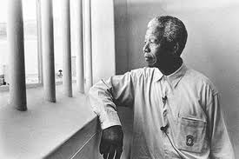
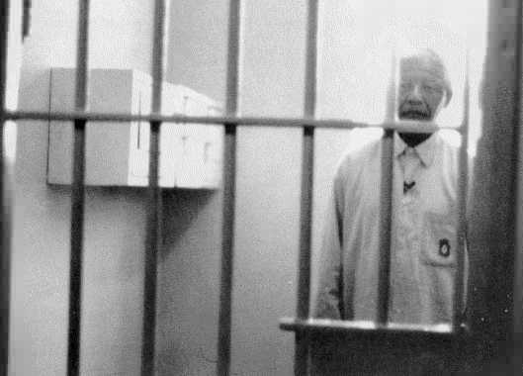

Slide 14
C. South Africa pg.2
One of the members imprisoned was Nelson Mandela. Mandela was the leader of the ANC and fought against segregation.
In 1989, white South Africans elected a new president, F.W. de Klerk. He wanted to transform South Africa and end its isolation.
In 1990 he legalized the ANC and released Mandela from prison and in 1994 Mandela was elected president of South Africa.

Slide 15
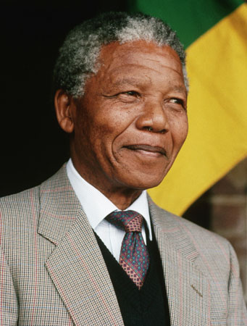
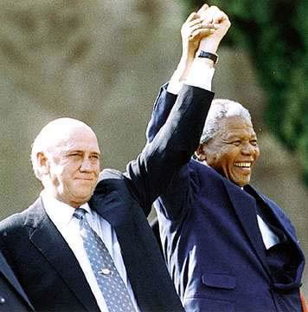
Nelson Mandela
F.W. de Klerk & Nelson Mandela

Slide 16
D. Israel and Its Neighbors
1. Israel and Arab Conflict
Following it’s creation in 1947, Israel has experienced hostility from it’s neighbors.
The day after it proclaimed itself a state, six Islamic states Egypt, Iraq, Jordan, Lebanon, Saudi Arabia, and Syria- invaded Israel.
This first of many Arab-Israeli wars ended in victory for Israel.
By early 1967, Egyptian president and his allies felt ready to confront Israel.

Slide 17
D. Israel and Its Neighbors
1. Israel and Arab Conflict pg.2
Convinced that the Arabs were about to attack, Israel went on the offensive.
The Israelis struck airfields in Egypt, Iran, Jordan, and Syria.
Safe from air-attacks, Israel was able to quickly move forward and defeat the Arab states. This would become known as the Six-Day War.
Israel lost 800 troops, while Arab losses exceeded 15,000.

Slide 18
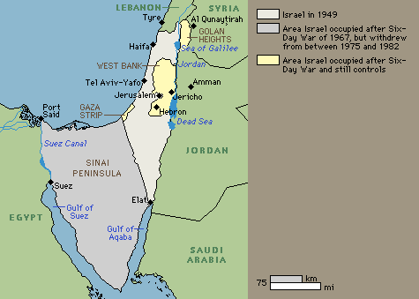

Slide 19
D. Israel and Its Neighbors
1. Israel and Arab Conflictpg.3
In October 1973, Egyptian president, Anwar Sadat, planned a joint Arab attack on Yom Kippur (Jewish holy holiday).
The Israelis were caught off guard and ultimately experienced heavy casualties and lost some territory.
In response, Golda Meir, Israeli prime minister launched a counterattack and regained most of the lost territory.
In 1977, Sadat and Israeli prime minister Menachem, met at Camp David in the U.S to negotiate a treaty. Ultimately Egypt recognized Israel as a state and Israel gave back the Sinai Peninsula to Egypt. This agreement became known as the Camp David Accords.

Slide 20
D. Israel and Its Neighbors
2. Palestine Liberation Organization
A large number of Palestinians still lived in Israeli owned territories such as the West Bank and Gaza Strip.
During the 1970’s and 1980’s the military wing of the PLO intensified its armed struggle against Israel. Israel responded by bombing Palestinian towns.
Conflict continued between the two until a peace agreement was reached in Oslo, Norway. This agreement would become known as the Oslo Peace Accords. This gave Palestine self rule of the Gaza Strip and West Bank.

Slide 21
D. Israel and Its Neighbors
2. Palestine Liberation Organization pg.2
In 1995, Israeli prime minister was assassinated by an extremist who opposed concessions to the Palestinians.
This was an example of the failure of the agreement and in 2000, when an Israeli political leader visited the Temple Mount in Jerusalem, a Jewish holy place, sparked another Palestinian uprising.
In 2003 George W.Bush tried to bring the two sides together in order to reach another agreement. It seemed that both sides appeared committed to reaching an agreement.

Slide 22
E. Islamic Fundamentalism
Following World War II, Iran’s leader Shah Mohammed Pahlavi, embraced Western governments and wealthy oil companies.
Iranian nationalist resented these foreign alliances.
Religious opposition leader, Ayatollah Khomeini, was living in exile. Spurred by his tape-recorded messages, Iranians rioted in every city in late 1978, the shah fled Iran in 1979 and Khomeini returned to establish a Islamic state.

Slide 23
E. Islamic Fundamentalism pg.2
In the 1970’s, a Muslim revolt threatened to topple Afghanistan’s Communist regime.
This led to a Soviet invasion in 1979.
The Afghan rebels call mujahideen, or holy warriors, fought back pushing the Soviets out in 1989.
Islamic religious students, were among the mujahideen who fought back. One of these groups, the Taliban, seized power and established an Islamic government based on extremist interpretations of Islamic law.

Slide 24
F. Persian Gulf War
The Persian Gulf War,. Jan.–Feb., 1991, was an armed conflict between Iraq and a coalition of 32 nations including the United States, Britain, Egypt, France, and Saudi Arabia
It was a result of Iraq's invasion of Kuwait on Aug. 2, 1990
Iraq then annexed Kuwait, which it had long claimed.
Iraqi president Saddam Hussein declared that the invasion was a response to overproduction of oil in Kuwait. Committing “economic warfare”.

Slide 25
F. Persian Gulf War pg.2
The main coalition forces invaded Kuwait and S. Iraq on Feb. 24.
Over the next four days, troops encircled and defeated the Iraqis and liberated Kuwait.
When U.S. President George H. W. Bush declared a cease-fire on Feb. 28, most of the Iraqi forces in Kuwait had either surrendered or fled.

Slide 26
F. Persian Gulf War pg.3
For decades, Kurds have wanted their own separate country.
But traditional lands cross the borders of three nations- Turkey, Iran, Iraq.
In the past, the Turks responded to Kurdish nationalism by forbidding Kurds to speak their native language.
In 1980s, Iraqis persecuted the Kurds, killing 5,000. The U.N has been working to end the persecution of the Kurdish people.

